Slide 1


http://www.comp.nus.edu.sg/~cs2100/
Lecture #19
Sequential Logic

Slide 2
Questions?
Ask at
https://sets.netlify.app/module/676ca3a07d7f5ffc1741dc65
OR
Scan and ask your questions here! (May be obscured in some slides)

Slide 3
6.3 Flip-flop Excitation Tables (1/2)
Analysis: Starting from a circuit diagram, derive the state table or state diagram.
Design: Starting from a set of specifications (in the form of state equations, state table, or state diagram), derive the logic circuit.
Characteristic tables are used in analysis.
Excitation tables are used in design.

Slide 4
6.3 Flip-flop Excitation Tables (1/2)
Excitation tables: given the required transition from present state to next state, determine the flip-flop input(s).
JK Flip-flop
SR Flip-flop
D Flip-flop
T Flip-flop

Slide 5
6.4 Sequential Circuits: Design
Design procedure:
Start with circuit specifications – description of circuit behaviour, usually a state diagram or state table.
Derive the state table.
Perform state reduction if necessary.
Perform state assignment.
Determine number of flip-flops and label them.
Choose the type of flip-flop to be used.
Derive circuit excitation and output tables from the state table.
Derive circuit output functions and flip-flop input functions.
Draw the logic diagram.

Slide 6
6.4 Design: Example #1 (1/5)
Given the following state diagram, design the sequential circuit using JK flip-flops.
0
Questions:
How many flip-flops are needed?
How many input variable are there?
00
1
1
1
01
11
0
Answers:
Two flip-flops. Let’s call them A and B.
One input variable. Let’s call it x.
0
1
10
0

Slide 7
6.4 Design: Example #1 (2/5)
Circuit state/excitation table, using JK flip-flops.
0
00
1
1
1
01
11
0
0
1
10
0
0 X
0 X
1 X
X 1
X 0
0 X
1 X
X 0
X 1
0 X
1 X
0 X
X 0
JK Flip-flop’s
excitation table.
X 0
X 0
X 1

Slide 8
6.4 Design: Example #1 (3/5)
Block diagram.
A'
A
B'
B
Q'
Q
Q'
Q
K
J
K
J
CP
KA
JA
KB
JB
A'
Combinational
circuit
A
External
output(s)
(none)
B
B'
x
External
input(s)
What are to go in here?

Slide 9
6.4 Design: Example #1 (4/5)
From state table, get flip-flop input functions.
Bx
B
A
00 01 11 10
0
1
0
0
0
1
A
X
X
X
X
x
JA = B∙x'
Bx
B
A
00 01 11 10
B
B
0
1
X
X
X
X
Bx
Bx
A
00 01 11 10
A
00 01 11 10
A
0
0
1
0
0
1
0
1
X
X
0
1
X
X
0
1
x
A
0
1
X
X
A
X
X
1
0
KA = B∙x
x
x
JB = x
KB = (A ⊕ x)'

Slide 10
6.4 Design: Example #1 (5/5)
Flip-flop input functions:
JA = B∙x' JB = x
KA = B∙x KB = (A ⊕ x)'
Logic diagram:
A
B
Q'
Q
Q'
Q
K
J
K
J
CP
x

Slide 11
6.4 Design: Example #2 (1/3)
Using D flip-flops, design the circuit based on the state table below. (Exercise: Design it using JK flip-flops.)

Slide 12
6.4 Design: Example #2 (2/3)
Determine expressions for flip-flop inputs and the circuit output y.
Bx
B
A
00 01 11 10
0
1
0
0
0
1
DA = A∙B' + B∙x'
A
1
1
0
1
x
Bx
B
A
00 01 11 10
0
1
0
1
1
0
DB = A'∙x + B'∙x + A∙B∙x'
A
0
1
0
1
x
Bx
B
DA(A,B,x) = Σ m(2,4,5,6)
DB(A,B,x) = Σ m(1,3,5,6)
y(A,B,x) = Σ m(1,5)
A
00 01 11 10
0
1
0
1
0
0
y = B'∙x
A
0
1
0
0
x

Slide 13
6.4 Design: Example #2 (3/3)
From derived expressions, draw logic diagram:
DA = A∙B' + B∙x'
DB = A'∙x + B'∙x + A.B∙x'
y = B'∙x
D
Q
A
x
A'
Q'
D
Q
B
Q'
B'
CP
y

Slide 14
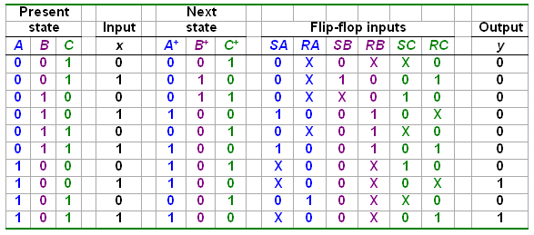
6.4 Design: Example #3 (1/4)
Design involving unused states.
Are there other unused states?
Given these
Derive these
Unused state 000:

Slide 15
6.4 Design: Example #3 (2/4)
From state table, obtain expressions for flip-flop inputs.
Cx
C
Cx
C
AB
00 01 11 10
AB
00 01 11 10
00
01
11
10
X
X
0
0
00
01
11
10
X
X
X
X
0
1
1
0
X
0
0
X
B
B
X
X
X
X
X
X
X
X
A
A
X
X
X
0
0
0
0
1
SA = B∙x
RA = C∙x'
x
x
Cx
C
Cx
C
AB
00 01 11 10
AB
00 01 11 10
00
01
11
10
X
X
1
0
00
01
11
10
X
X
0
X
X
0
0
0
0
1
1
1
B
B
X
X
X
X
X
X
X
X
A
A
0
0
0
0
X
X
X
X
SB = A'∙B'∙x
x
x
RB = B∙C + B∙x

Slide 16
6.4 Design: Example #3 (3/4)
From state table, obtain expressions for flip-flop inputs (cont’d).
Cx
C
Cx
C
AB
00 01 11 10
AB
00 01 11 10
00
01
11
10
X
X
0
X
00
01
11
10
X
X
1
0
1
0
0
X
0
X
1
0
B
B
X
X
X
X
X
X
X
X
A
A
SC = x'
1
0
0
X
0
X
1
0
RC = x
x
x
Cx
C
AB
00 01 11 10
00
01
11
10
X
X
0
0
0
0
0
0
B
X
X
X
X
A
0
0
1
1
y = A∙x
x

Slide 17
6.4 Design: Example #3 (4/4)
From derived expressions, draw the logic diagram:
SA = B∙x SB = A'∙B'∙x SC = x' y = A∙x
RA = C∙x' RB = B∙C + B∙x RC = x
y
x
S
Q
A
R
Q'
A'
S
Q
B
R
Q'
B'
S
Q
C
R
Q'
CP

Slide 18
7. Memory (1/4)
Memory stores programs and data.
Definitions:
1 byte = 8 bits
1 word: in multiple of bytes, a unit of transfer between main memory and registers, usually size of register.
1 KB (kilo-bytes) = 2¹⁰ bytes; 1 MB (mega-bytes) = 2²⁰ bytes; 1 GB (giga-bytes) = 2³⁰ bytes; 1 TB (tera-bytes) = 2⁴⁰ bytes.
Desirable properties: fast access, large capacity, economical cost, non-volatile.
However, most memory devices do not possess all these properties.

Slide 19
7. Memory (2/4)
Memory hierarchy
Fast, expensive (small numbers), volatile
registers
main memory
disk storage
Slow, cheap (large numbers), non-volatile
magnetic tapes

Slide 20
7. Memory (3/4)
Data transfer
Address
Memory
Up to 2^{k} addressable locations.
0
1
2
3
4
5
Processor
k-bit address bus
MAR
n-bit data bus
MDR
:
Control lines
(R/W, etc.)

Slide 21
7. Memory (4/4)
A memory unit stores binary information in groups of bits called words.
The data consists of n lines (for n-bit words). Data input lines provide the information to be stored (written) into the memory, while data output lines carry the information out (read) from the memory.
The address consists of k lines which specify which word (among the 2^{k} words available) to be selected for reading or writing.
The control lines Read and Write (usually combined into a single control line Read/Write) specifies the direction of transfer of the data.

Slide 22
7.1 Memory Unit
Block diagram of a memory unit:
n data input lines
n
k
Memory unit
2^{k} words
n bits per word
k address lines
Read/Write
n
n data output lines

Slide 23
7.2 Read/Write Operations
Write operation:
Transfers the address of the desired word to the address lines.
Transfers the data bits (the word) to be stored in memory to the data input lines.
Activates the Write control line (set Read/Write to 0).
Read operation:
Transfers the address of the desired word to the address lines.
Activates the Read control line (set Read/Write to 1).

Slide 24
7.3 Memory Cell
Two types of RAM
Static RAMs use flip-flops as the memory cells.
Dynamic RAMs use capacitor charges to represent data. Though simpler in circuitry, they have to be constantly refreshed.
A single memory cell of the static RAM has the following logic and block diagrams:
Select
Select
R
S
Input
Q
Output
Input
BC
Output
Read/Write
Read/Write
Logic diagram
Block diagram

Slide 25
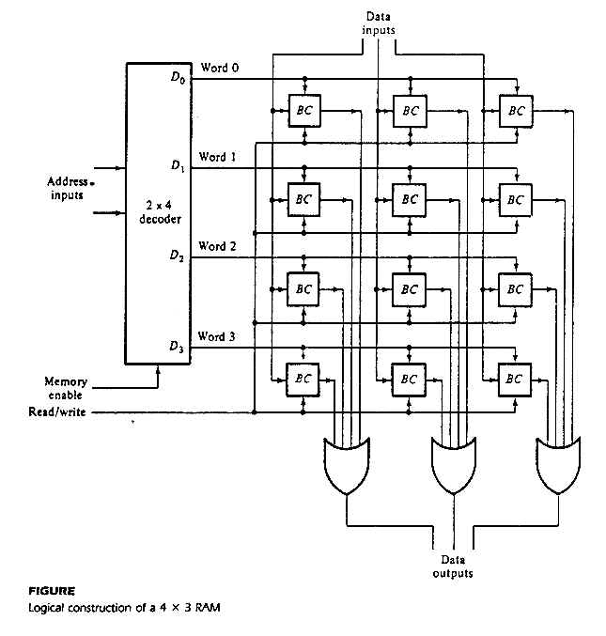
7.4 Memory Arrays (1/4)
Logic construction of a 4×3 RAM (with decoder and OR gates):

Slide 26
7.4 Memory Arrays (2/4)
An array of RAM chips: memory chips are combined to form larger memory.
A 1K × 8-bit RAM chip:
RAM 1K x 8
Input data
Address
Chip select
Read/write
8
DATA (8)
ADRS (10)
CS
RW
(8)
8
Output data
10
Block diagram of a 1K x 8 RAM chip

Slide 27
7.4 Memory Arrays (3/4)
Address
Input data
Lines
Lines
8 lines
11 10
0 – 9
0–1023
DATA (8)
ADRS (10)
CS
RW
(8)
2x4 decoder
1K x 8
S₀
S₁
0
1
2
3
1024 – 2047
DATA (8)
ADRS (10)
CS
RW
(8)
1K x 8
2048 – 3071
Read/write
DATA (8)
ADRS (10)
CS
RW
(8)
1K x 8
4K × 8 RAM.
3072 – 4095
DATA (8)
ADRS (10)
CS
RW
(8)
1K x 8
Output data

Slide 28
7.4 Memory Arrays (4/4)
Read/write control line not included in this diagram.
21-bit
A
addresses
19-bit internal chip address
A
0
1
A
19
A
20
2-bit
decoder
512K x 8 memory chip
512k X 8
memory chip
D
D
D
D
31-24
23-16
15-8
7-0
19-bit
address
8-bit data
input/output
2M × 32 memory module
Using 512K × 8 memory chips.
Chip select

Slide 29
End of File

